Slide 1
ELERt
Early detection and HWC response system

Slide 2
Overview
Munene and the elephant (Bracelet-UI)
The chieftain (SMS-response)
Peace Parks (Web-app UI)
The grid and the people (System architecture)
The future of elert (AI-powered functionalities in web-app)

Slide 3
Munene and the elephant
Munene walks along the edge of his family’s farm situated in the outskirts of the community.
The bracelet his father gave him suddenly lights up. His father told him to keep watch for elephants if this bracelet lights up.
Elephants occasionally broke through neighbors' defenses and ate the crops, but never Munene’s, and so he keeps strolling.
Suddenly, at the far end of the crops, he sees some grey figures, slowly moving along the treeline. Elephants.
Being alone, he decides to run to the village chief and tell him about the sistuation.

Slide 4
the Chief
Munene rushes to the chieftain, but as he arrives, he sees him discussing with the other elders about an elephant in the area.
The chieftain had received an automatic SMS-alert (on his Nokia phone) from Peace Park about elephants in the area.
Now, with Munene’s help, they were able to determine their exact location and prepare themselves in time.
They choose to notify Peace Park that the elephant has been found, in order to receive help from authorities

Slide 5
Peace Parks
One of the rangers at Peace Parks, receives the chieftain’s reply on her smart phone and check the web-app for activity
She calls authorities with more resources, to head to the village and see the chieftain to safely resolve the conflict
The ranger can see on her device that this group of elephants have been in the area many times before
This means that they won’t spook easily and may have to be relocated to another part of the park.
The authorities are notified of this and deploy proper countermeasures, tranquilizing the elephant.

Slide 6
The Elert-system
Early detection system
Enable locals to enact solutions by giving them time and awareness
Different levels of countermeasures can be taken at each step
Proximity alert system (GPS)
Chiefs
SMS-response alert
Farmers
Collaborate with authorities
Organize local-response
Bracelet alert system
Peace Parks
Notify chieftain of location

Slide 7
The Technology
Backend system:
Collects GPS-data on elephant position
Compares elephant position with user position
Sends signals to 3 different UIs
(UI)
(UI) Bracelet warning system:
Embedded system

Slide 8
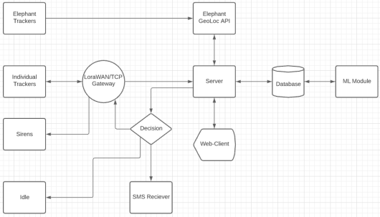
The Technology

Slide 9
The Technology

Slide 10
Add a Slide Title - 1

Slide 11
Add a Slide Title - 2

Slide 12
Add a Slide Title - 3

Slide 14
Add a Slide Title - 4

Slide 15
Add a Slide Title - 5

